Slide 1
LTMA: Layered Topic Matching for the Comparative Exploration, Evaluation, and Refinement of Topic Modeling Results
Reference to this paper:
M. El-Assady, F. Sperrle, R. Sevastjanova, M. Sedlmair and D. Keim, "LTMA: Layered Topic Matching for the Comparative Exploration, Evaluation, and Refinement of Topic Modeling Results," 2018 International Symposium on Big Data Visual and Immersive Analytics (BDVA), Konstanz, 2018, pp. 1-10, doi: 10.1109/BDVA.2018.8534018
Link to this paper:
https://ieeexplore.ieee.org/abstract/document/8534018

Slide 2
What is the problem?
There are many types of topic modelling algorithms.
Due to this it is difficult to analyze which algorithm is suitable.
A quantitative result comparison of two algorithms would enable scholars to choose the best algorithm.

Slide 3
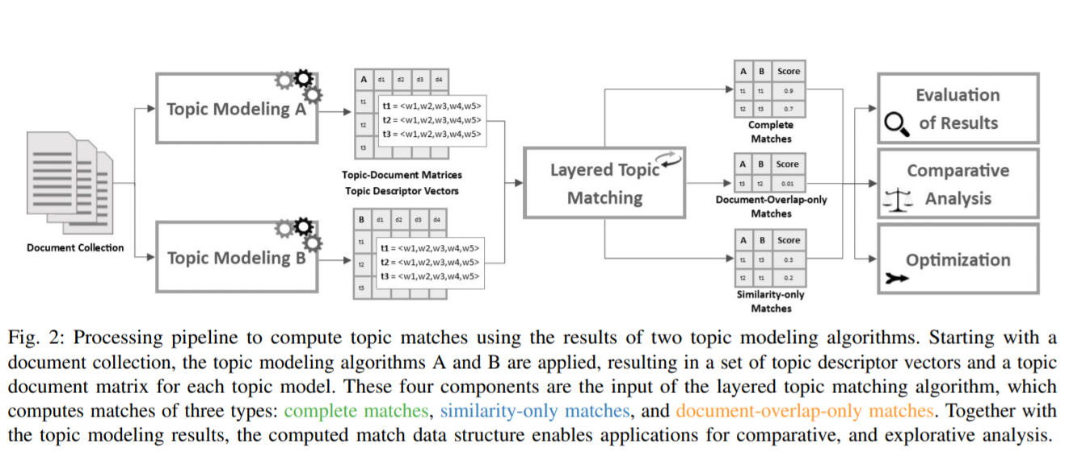
Method Proposed - LTMA
Notes:
In this paper, an algorithm for comparing the results of topic models and calculating the similarities between two sets of given topics defined over the same corpus.
Complete match, where the keywords of two topics, as well as their respective documents, match.
similarity-only match, where only the keywords of two topics match.
Document-overlap only match of two topics as a strong overlap of their document vectors, but significantly low similarity of their keywords.

Slide 4
Similarity Measures
To group documents into different topics, the content similarity of the texts has to be captured.
The three most powerful text similarity functions are the cosine similarity, the Jaccard similarity, and Dice’s coefficient.

Slide 5
Requirement Analysis
Most scholars, usually read large parts of the texts and manually label documents and topics.
Another approach is to manually match the result of two well-established topic modeling algorithms.
But to avoid the risk factors in above methods we need an automatic way.

Slide 6
LTMA building blocks
LTMA works on 2 topic modelling algorithms.
The results are matched in 3 different types.
Complete match - keywords of two topics, as well as their respective documents, match
Similarity only match - only the keywords of two topics match
Document-Overlap only match - a strong overlap of their document vectors

Slide 7
LTMA Working
LTMA follows three steps to compute matching topic pairs, as well as their degree of similarity and document overlap.
Step 1: Calculate topic similarities and document overlaps
Step 2: Generate potential topic match-candidates
Step 3: Evaluate potential topic matches

Slide 8
Ranked and Weighted Penalty Distance
The computation of the weighted keyword distance between two topic descriptor vectors is designed to approximate manual matching.
A weight is assigned to each word proportional to its importance for the topic.
For all keyword pairs in both vectors, the weighted penalty values are calculated and summed up.

Slide 9
Document-Overlap-Based Matching
For each topic t1 from one model, we determine the topic t2, from the other model.
such a topic by counting the common documents of all topic pairs and normalizing them by the number of documents containing t1 is called document-match frequency.

Slide 10
Similarity-Based Matching
For each topic pair and its measured distance, a normalized similarity value is computed.
Eventually, if a similarity value exceeds a given threshold, its matching pair is considered a potential similarity-match.

Slide 11
Automatic Comparative Evaluation
Cross fold evaluation method verifies the replicability and stability of topic models.
LTMA can be used for automatically measuring and comparing the interpretability of topic models.
Differences and common factors of two models can be determined and evaluated using LTMA

Slide 12
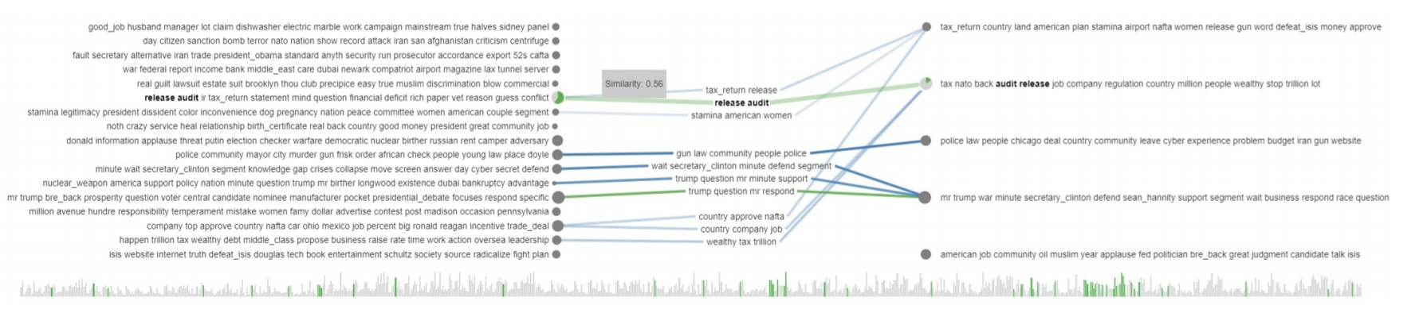
Interactive visualization interface

Slide 13
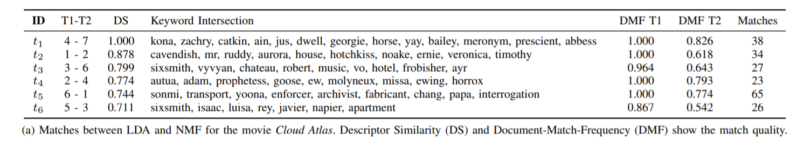
Optimizing Model Results
The complete matching result of LTMA can be regarded as a filtering criterion for relevant topics.

Slide 14
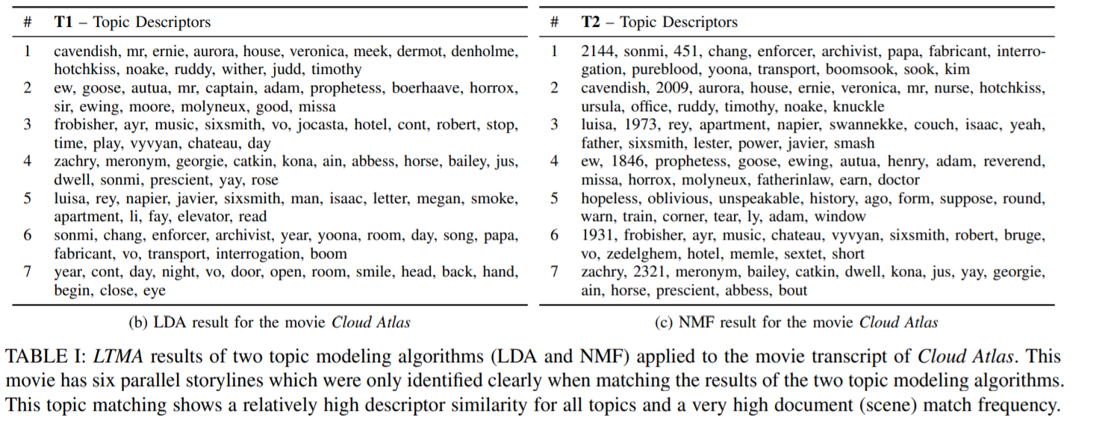
Topic Relations

Slide 15
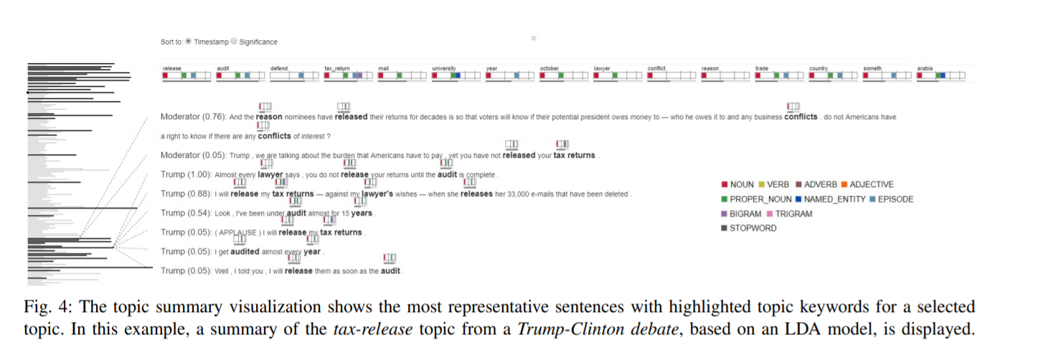
Visual Exploration of Topic Modeling Differences

Slide 16
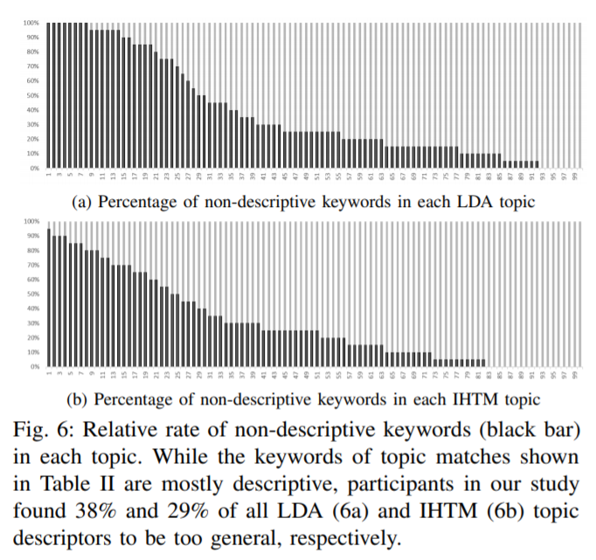
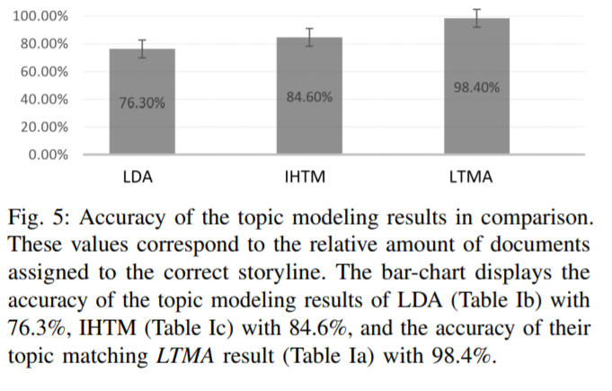
Performance analysis

Slide 17
Conclusion
Introduced a layered topic matching algorithm that operates on the results of topic models to generate a topic match data structure.
Extend the algorithm to enable matching the results of more than two topic models at a time.
We plan to extend it to incorporate probabilistic topic models, enabling probabilistic topic match data structures.

Slide 18
Thank You

